Slide 1
PEHCHAAN EK SAFAR
Review report
Oct-Nov 2018

Slide 3
OUTLOOK
INTRODUCTION
Various events
Meeting with parents
Diwali celebration
Pathshala initiative
Teams whatsapp group
Outreach activities
Chandigarh litrery fest 14 nov story session
Teaching and other activities improvements of kids
Betterment in working for volunteers
Others
STATUS OF LEGAL ASPECTS
BUDGET
CONCLUSION

Slide 4
Introduction
This presentation contains the overall report of group PEHCHAAN EK SAFAR during oct-nov 2018 . It contains various Tasks Undertaken, Achievements, Budget and other activities.

Slide 5
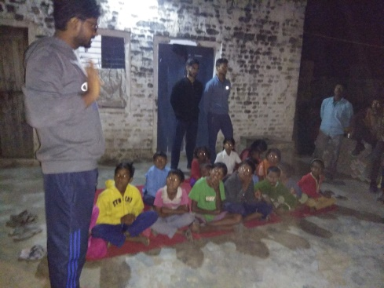
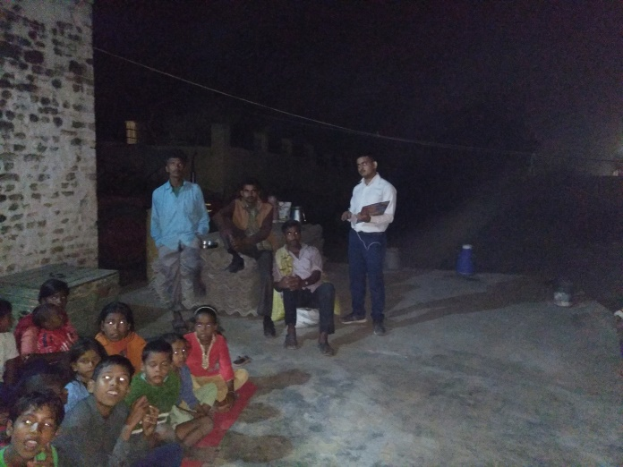
Events: parents meeting
Date and time: 1 -nov-18 at evening 6:30 2018
Venue : Temporary Pathshala space(rana’s land)
Objective:
1) To convey the current status of child to respective parents.
2) To discuss future goals and needs.
Outcome: Most of the objectives were discussed and positive response noted. Plan for pathshala initiated.

Slide 6
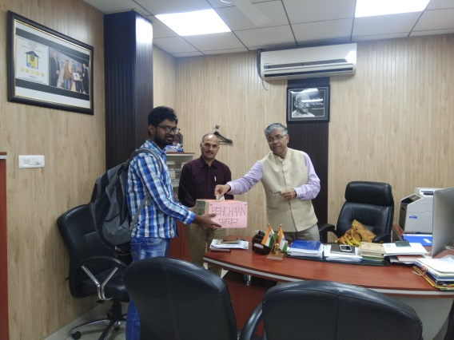
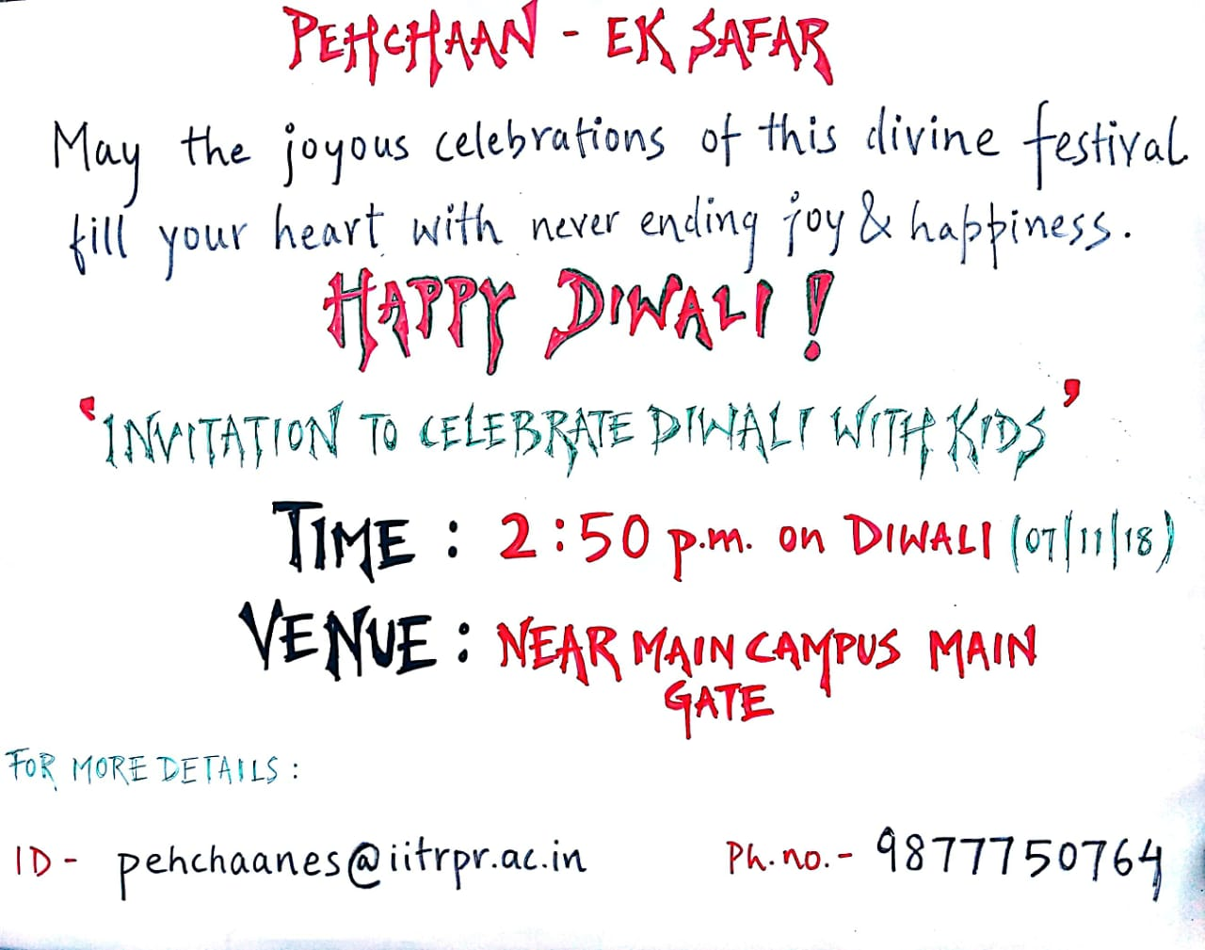
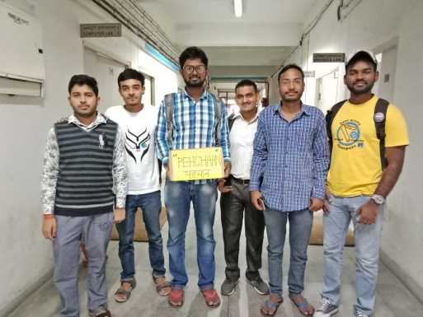
EVENTS: DIWALI CELEBRATION Donation Drive-DAY 1(6-nov-2018)

Slide 7
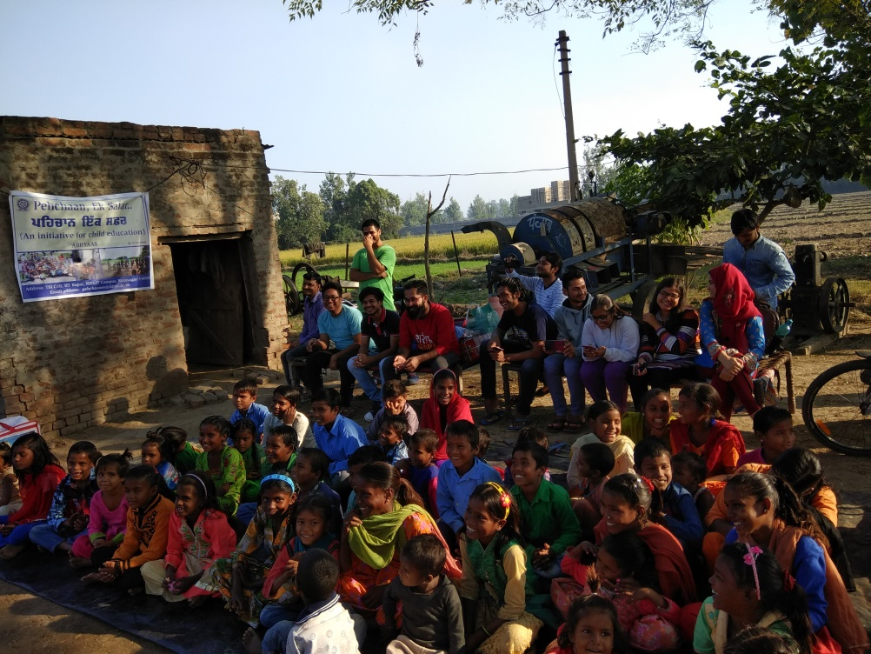
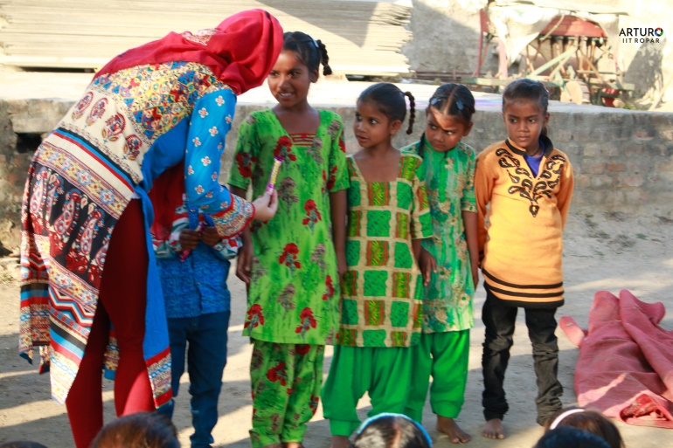
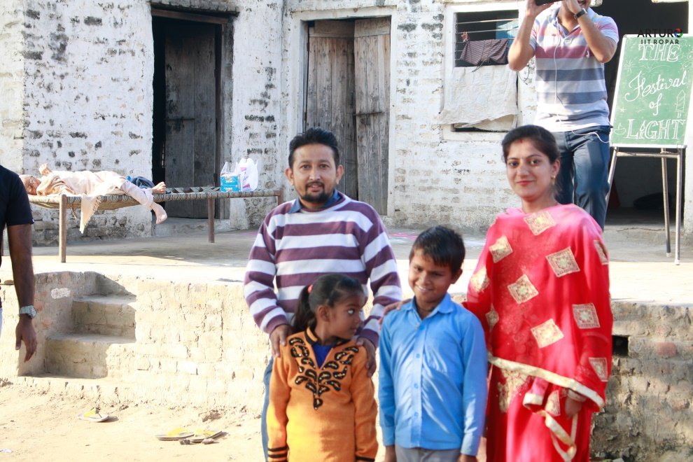
EVENTS: DIWALI CELEBRATION DAY 2(7-nov-2018)

Slide 8
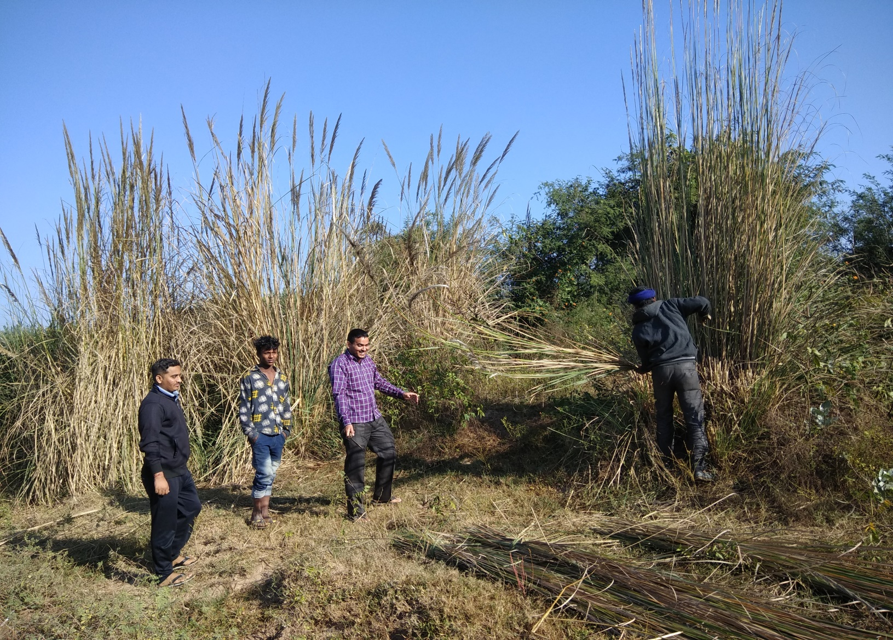
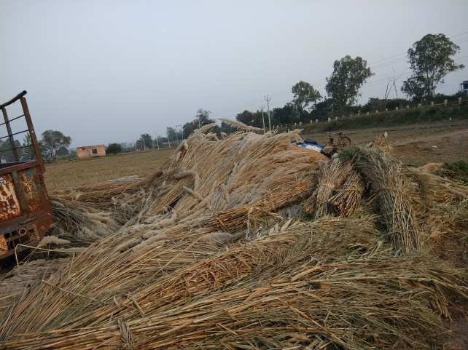
Pathsala initiative
Selected land: Mr. Ranveer rana’s other land near old place (100 m from main gate IIT Ropar
Starting time: last week of October
Note : In this project, parents are working with us and performing all the labour work.

Slide 9
Team whatsapp groups
Teaching group
Public relations and social media group
Logistics team
External affairs team
Office works team
Governing body
Pehchaan GB group
Resources and development

Slide 10
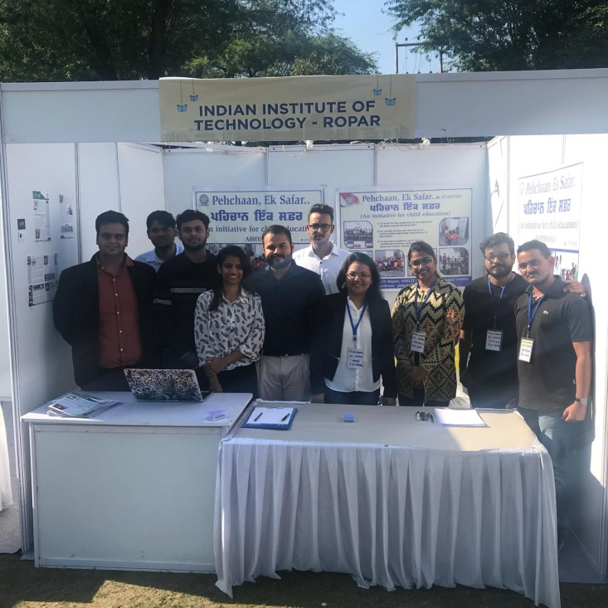
Outreach activities Chandigarh literati fest-2018
Date :17-nov-2018
Objective:
1)To showcase the literacy initiative and social work going on around campus
2) To get some exposure and make new contacts
Supported and guided by: Dr. Asad Sahir
(HOD professional development cell)
Outcomes:
Experience of presenting our work among respected luminaries like Piyush Mishra.
Gained potential supporters and volunteers.

Slide 11
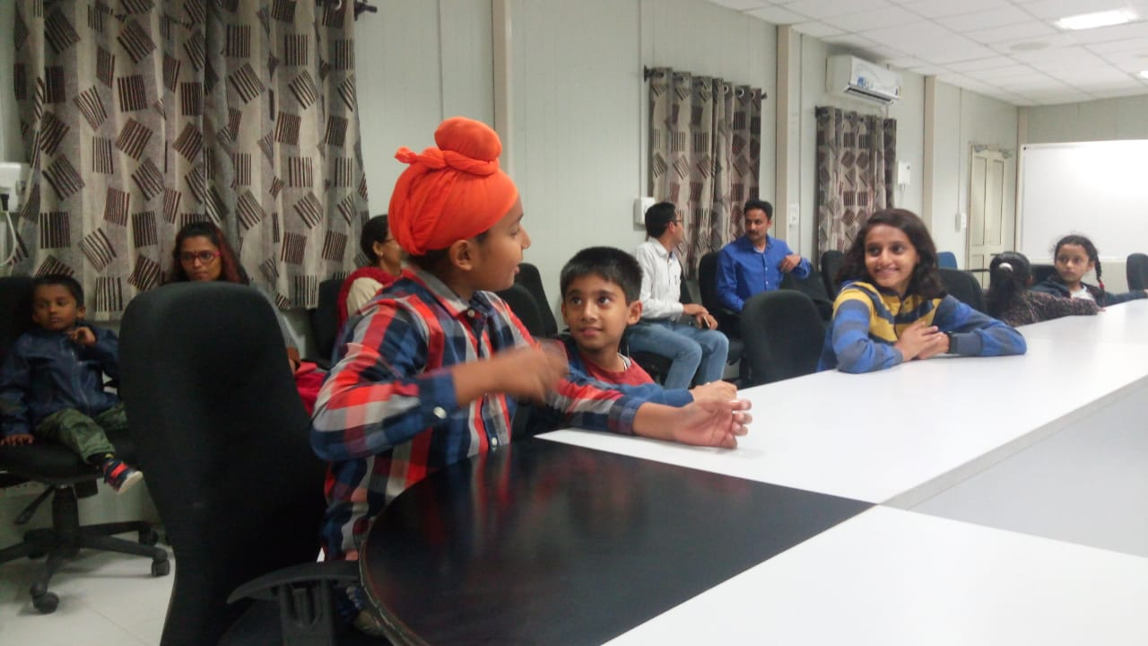
Outreach activities 14-NOV story session(iit ropar)
Date :14-nov-2018
Venue: CR -2 (TC1)IIT Ropar
Representative: Mr. Chetan Waghela
Objective : We had received an invitation from deputy-librarian IIT Ropar to narrate some story to IIT’s children on occasion of Children’s Day.

Slide 12
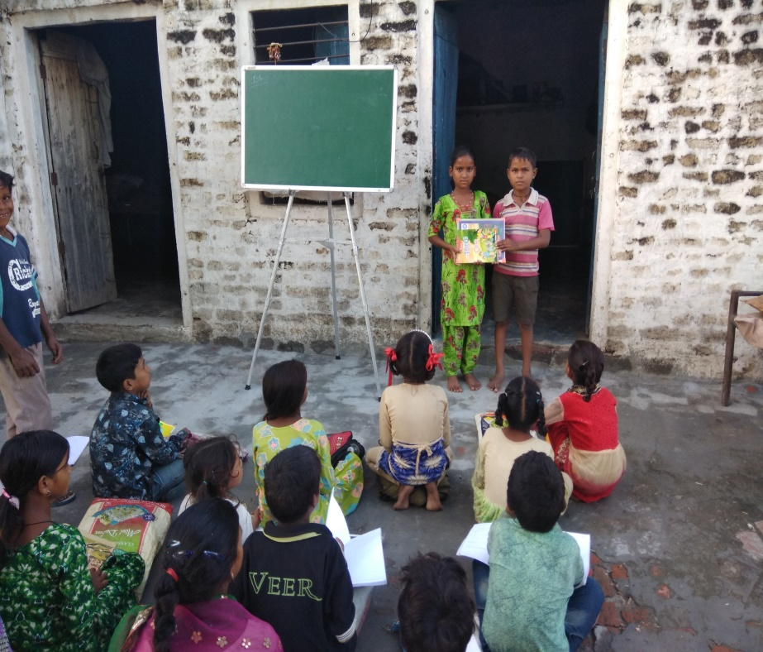
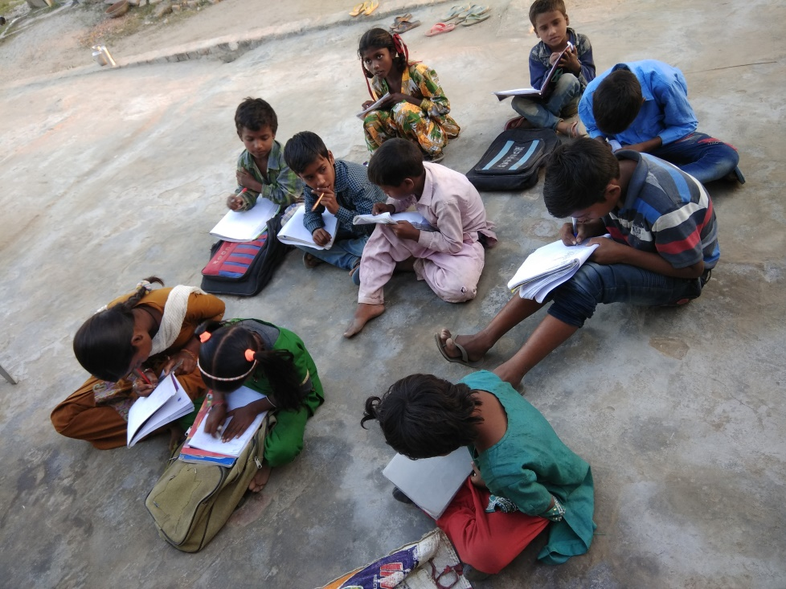
Teaching and other activities improvements

Slide 13
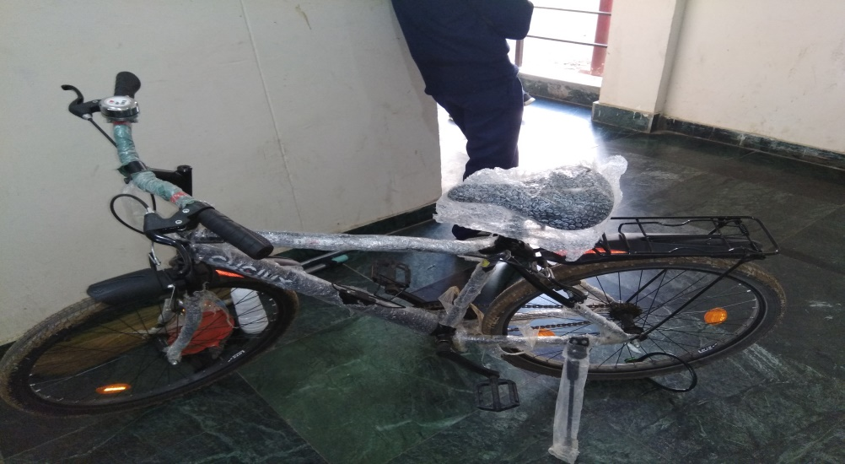
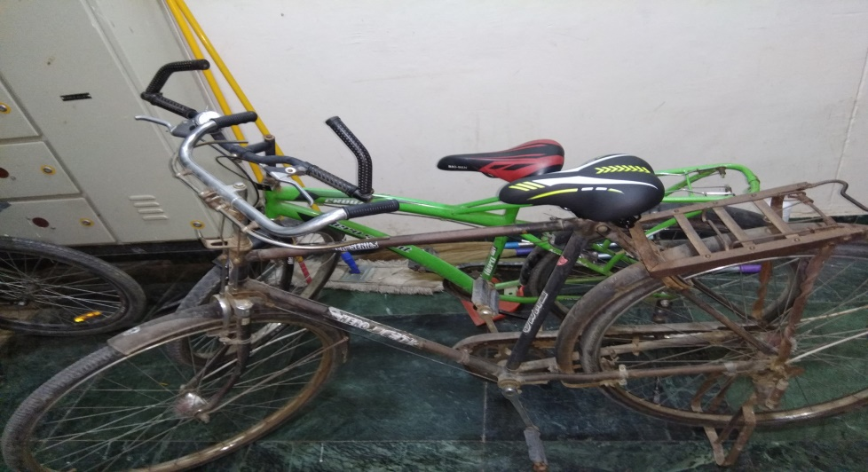
Betterment of the group functioning
Received 2 bicycles in donation one from mr. subhojit saha(phd scholar ) and from mr. Kausal (staff ME)
we purchased one more .
Separate teaching group have been formed and a three member team is functioning for managing all the matters related to teaching

Slide 15
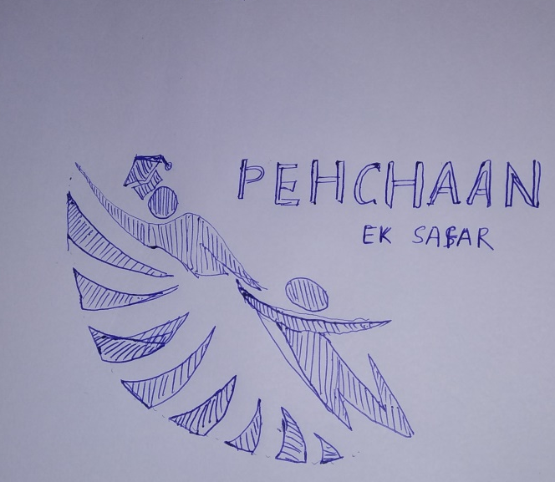
Status of legal aspects
Registration of NGO in process, which will soon be completed.
Creation of bank account after registration
Inputs for Logo.

Slide 16
Budget
Treasurer will present separate budget presentation

Slide 17
conclusion
Mr. President will present conclusion and future plans for discussion.

Slide 18
Thank you

